Slide 1
MACHINE LEARNING • PROJECT REPORT • A.Y. 2026-27
License Plate Recognition for
Traffic Monitoring Using CNN and OCR
A deep-learning + OCR pipeline for automated, scalable license-plate identification in real-world traffic scenes
PROJECT TEAM
UNDER THE GUIDANCE OF
Saahas Vaddi
2520030256
Lohith Sanapala
2520030023
Dr. Jyothsna
Professor, CSE Department

Slide 2
OVERVIEW
What We'll Cover
01
Introduction
05
Exploratory Data Analysis
The traffic-monitoring problem and why automation matters
Dataset structure, quality, and patterns
02
Abstract & Objectives
06
Key Observations
Project goals, dataset, and evaluation metrics
Insights that shape model design
03
Proposed Approach
07
Conclusion & Next Steps
CNN detection + OCR recognition pipeline
Roadmap toward a working prototype
04
System Requirements
Software stack and hardware setup
License Plate Recognition using CNN & OCR
2

Slide 3
INTRODUCTION
Why Automated License Plate Recognition?
Traffic congestion, road safety, and law-enforcement compliance are pressing challenges in a rapidly urbanizing world. As vehicle numbers rise every year, manual monitoring is no longer sufficient to keep traffic flowing safely and lawfully. Automated, AI-driven systems reduce human effort, minimize error, and prepare cities for future growth.
WHERE LPR ADDS VALUE
Traffic-flow & congestion monitoring
Automated violation & speed-limit detection
License Plate Recognition (LPR) automatically identifies vehicles by detecting and reading plates from images or video feeds — combining CNNs for robust plate detection with OCR for accurate character extraction.
Vehicle tracking for law enforcement
Smart-city & parking access control
License Plate Recognition using CNN & OCR
3

Slide 4
ABSTRACT & OBJECTIVES
Project Abstract
The integration of deep learning with Optical Character Recognition (OCR) is transforming traffic monitoring by enabling automated license plate recognition in real-world scenarios. CNNs extract spatial features from plate images while OCR ensures precise text recognition — an effective combination for surveillance and smart-city applications. The project uses the OpenALPR benchmark dataset, evaluated with accuracy and F1-score, to address challenges such as blurred images, angled plates, and poor lighting.
1
2
3
4
Scalable Detection
Robust Evaluation
Balanced Metrics
Smart-City Ready
Demonstrate a scalable LPR pipeline that minimizes manual intervention.
Benchmark against OpenALPR data under varied lighting & angles.
Measure accuracy and F1-score for both precision and recall.
Support intelligent, automated urban traffic infrastructure.
License Plate Recognition using CNN & OCR
4

Slide 5
PROPOSED APPROACH
CNN + OCR Recognition Pipeline
›
›
›
›
›
1
2
3
4
5
6
Input Image
Preprocessing
CNN Detection
Plate Crop
OCR (Tesseract)
Structured Output
Raw traffic-camera frame or photo
OpenCV: resize, denoise, contrast fix
Localize the license-plate region
Isolate the detected plate area
Extract characters as digital text
Plate number ready for logging
CNNs provide robust feature learning to locate plates under varying conditions, while OCR converts plate text into digital format — together forming a reliable system for traffic monitoring, violation detection, and vehicle tracking.
License Plate Recognition using CNN & OCR
5

Slide 6
SYSTEM REQUIREMENTS
Software & Hardware Stack
Real-time performance calls for an efficient software toolchain — for image processing, model training, and OCR — paired with hardware capable of handling computationally intensive tasks.
SOFTWARE STACK
HARDWARE SETUP
Python 3.8+
Core development language
Standard PC / Laptop
TensorFlow
CNN model implementation & training
Base compute platform
OpenCV
Image preprocessing & plate detection
8 GB RAM (min.)
Recommended for smooth training
NumPy / Pandas
Data handling & manipulation
GPU Support
Matplotlib / Seaborn
Exploratory analysis & visualization
Optional — accelerates CNN training
Tesseract OCR
Character recognition engine
License Plate Recognition using CNN & OCR
6

Slide 7
EXPLORATORY DATA ANALYSIS
Dataset Overview
EDA was performed on plate_dataset_updated.csv, an OpenALPR-style dataset of U.S. license-plate records spanning multiple states and plate styles.
CATEGORICAL FEATURES
NUMERICAL FEATURES
Image File
State
Plate Number
Reg_Status
Owner_Status
Slogan Text
Commemorative Text
Emblem Text
Description
Plate Style
Orientation
Reg_Month / Reg_Year
Registration date fields
Desc_Length
Length of the plate description text
Screw_Count
Number of mounting screws visible
Width_px / Height_px
Plate image dimensions in pixels
License Plate Recognition using CNN & OCR
7

Slide 8
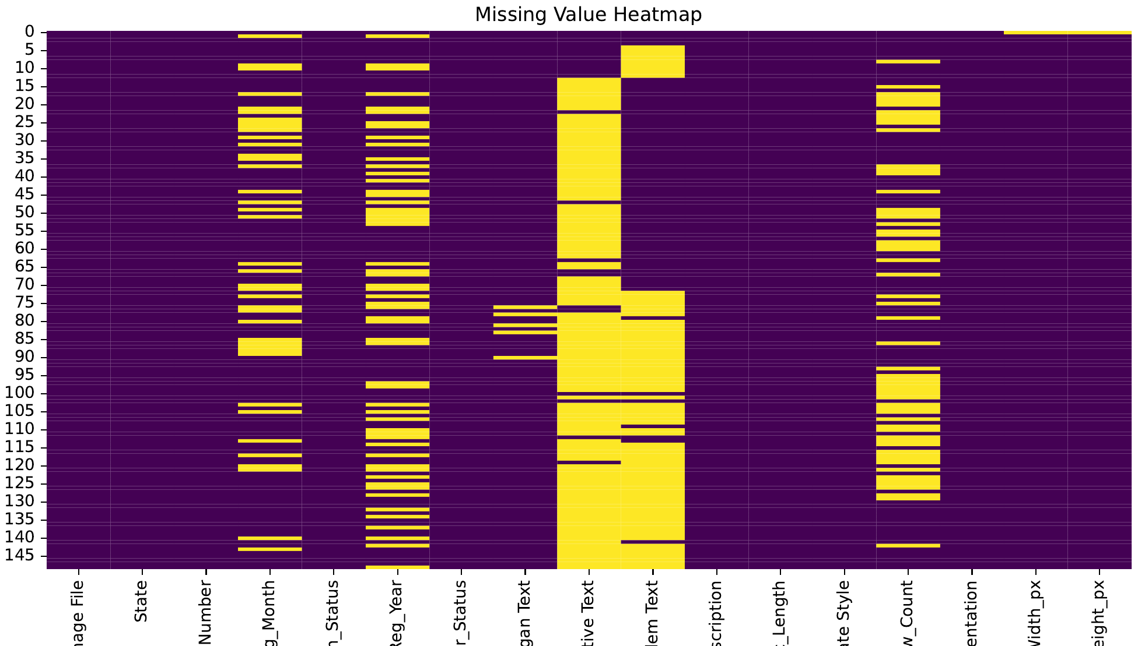
EXPLORATORY DATA ANALYSIS
Data Quality: Missing Value Heatmap
OBSERVATION
Several features contain missing values — notably Reg_Month, Reg_Year, Screw_Count, Commemorative Text, and Emblem Text. Width_px and Height_px each miss a single value.
These gaps need imputation or exclusion before model training to avoid biasing the CNN/OCR pipeline.
License Plate Recognition using CNN & OCR
8

Slide 9
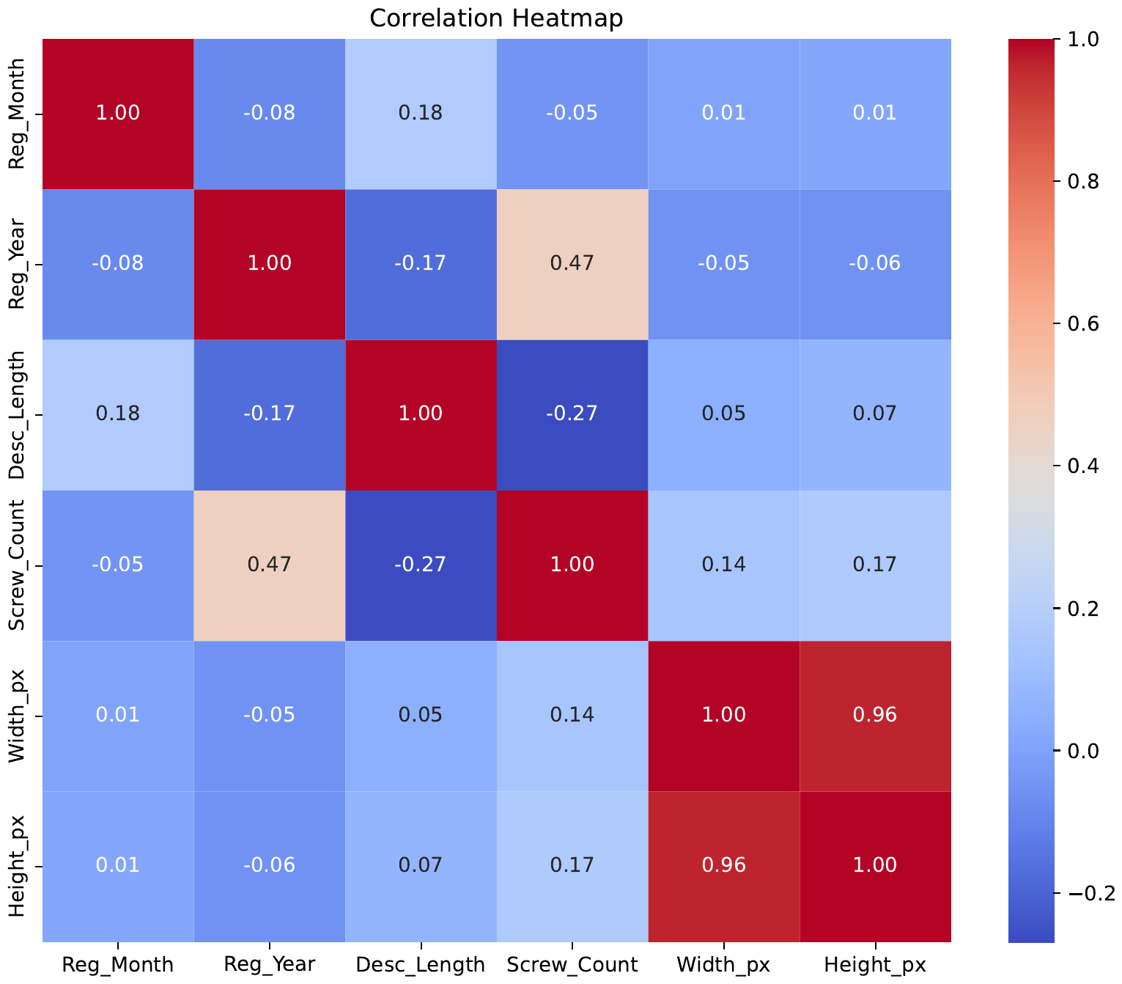
EXPLORATORY DATA ANALYSIS
Correlation Between Numerical Features
0.96
Width_px ↔ Height_px
0.47
Reg_Year ↔ Screw_Count
Most features are weakly correlated, meaning each carries distinct information for the model.
License Plate Recognition using CNN & OCR
9

Slide 10
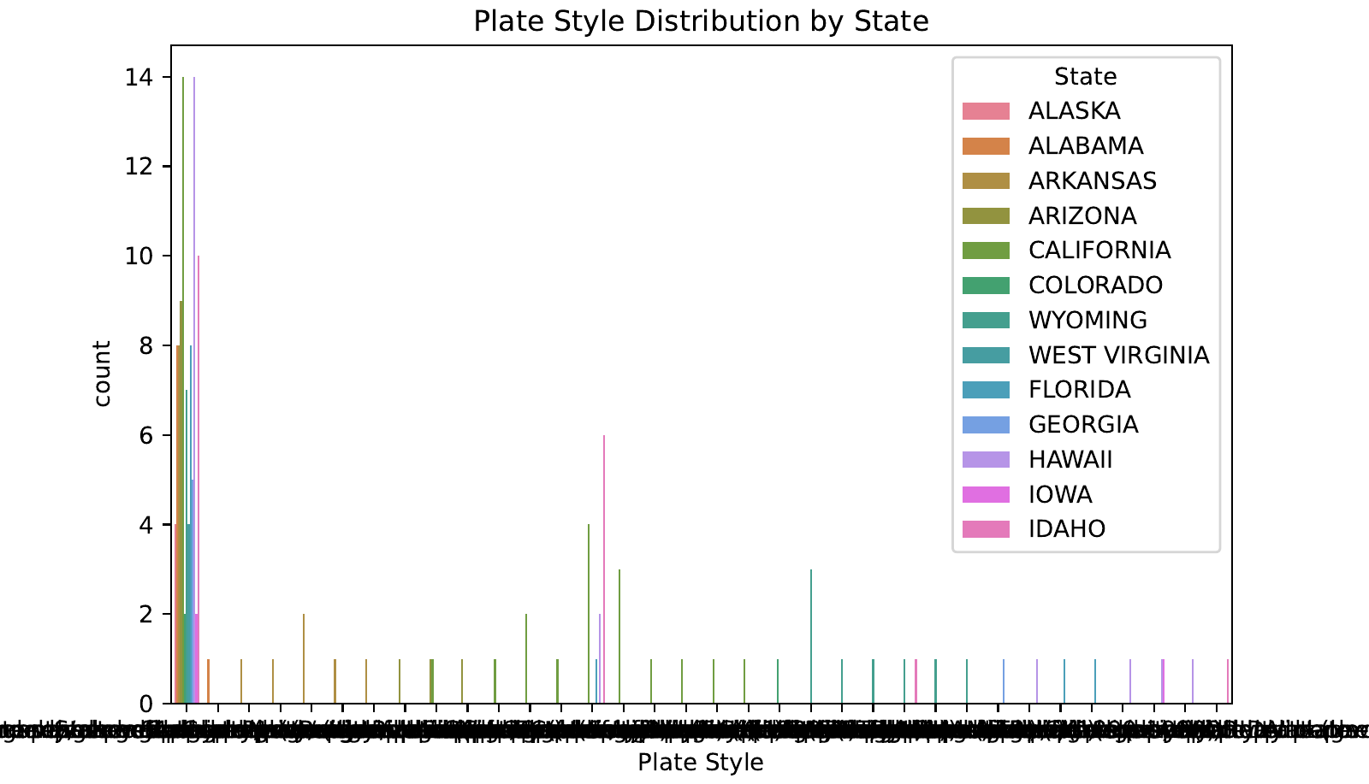
EXPLORATORY DATA ANALYSIS
Plate Style Distribution by State
Plate styles vary widely across states, with a long tail of low-frequency specialty and commemorative designs alongside a handful of dominant standard styles — a class-imbalance factor to account for during model training.
License Plate Recognition using CNN & OCR
10

Slide 11
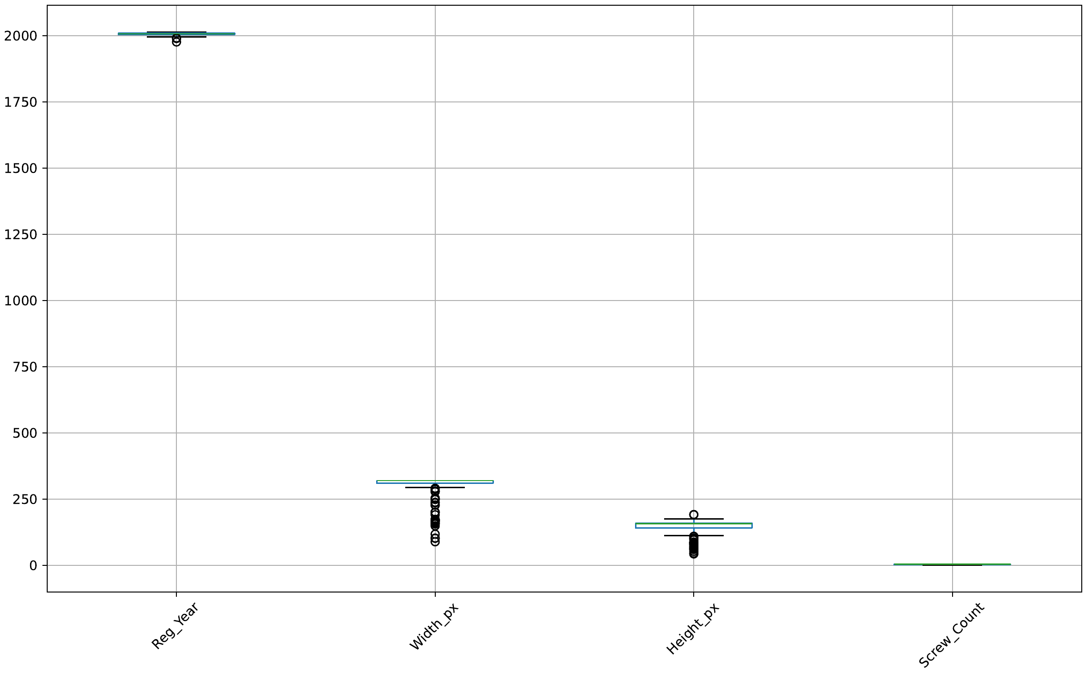
EXPLORATORY DATA ANALYSIS
Outlier Detection Across Numerical Fields
Boxplots of Reg_Year, Width_px, and Height_px reveal a number of outliers below the main cluster — likely scanning artifacts or rare plate formats — while Screw_Count stays tightly distributed near zero.
License Plate Recognition using CNN & OCR
11

Slide 12
KEY OBSERVATIONS
Key Observations
1
2
Missing Data
Strong Pixel Correlation
Reg_Month, Reg_Year, Screw_Count, and text fields need imputation or exclusion before training.
Width_px and Height_px correlate at 0.96 — one may be redundant as a model feature.
3
4
Class Imbalance
Outliers Present
Plate styles are dominated by a few standard designs, with many rare specialty styles.
Reg_Year, Width_px, and Height_px show outliers that warrant cleaning before CNN training.
License Plate Recognition using CNN & OCR
12

Slide 13
CONCLUSION
Conclusion & Next Steps
This project demonstrates how combining CNN-based plate detection with OCR character recognition can deliver a scalable, low-intervention traffic-monitoring solution. Initial EDA on the OpenALPR-style dataset clarifies data quality issues and feature relationships that will guide model design.
Clean missing values & handle outliers identified in EDA
1
Train the CNN plate-detection model on OpenALPR data
2
Integrate Tesseract OCR for character-level recognition
3
Evaluate performance using accuracy and F1-score
4
License Plate Recognition using CNN & OCR
13

Slide 14
Thank You
Questions & Discussion Welcome
Saahas Vaddi • Lohith Sanapala
Guided by Dr. Jyothsna, Professor, CSE

